Slide 1
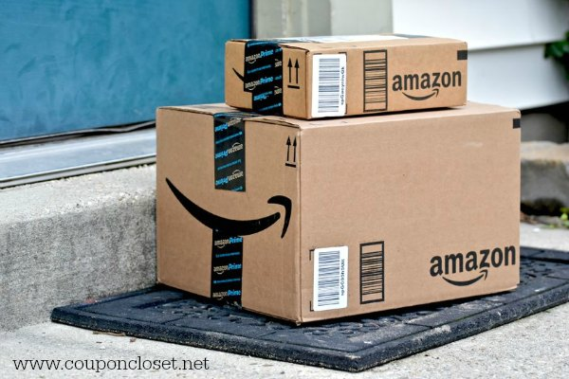
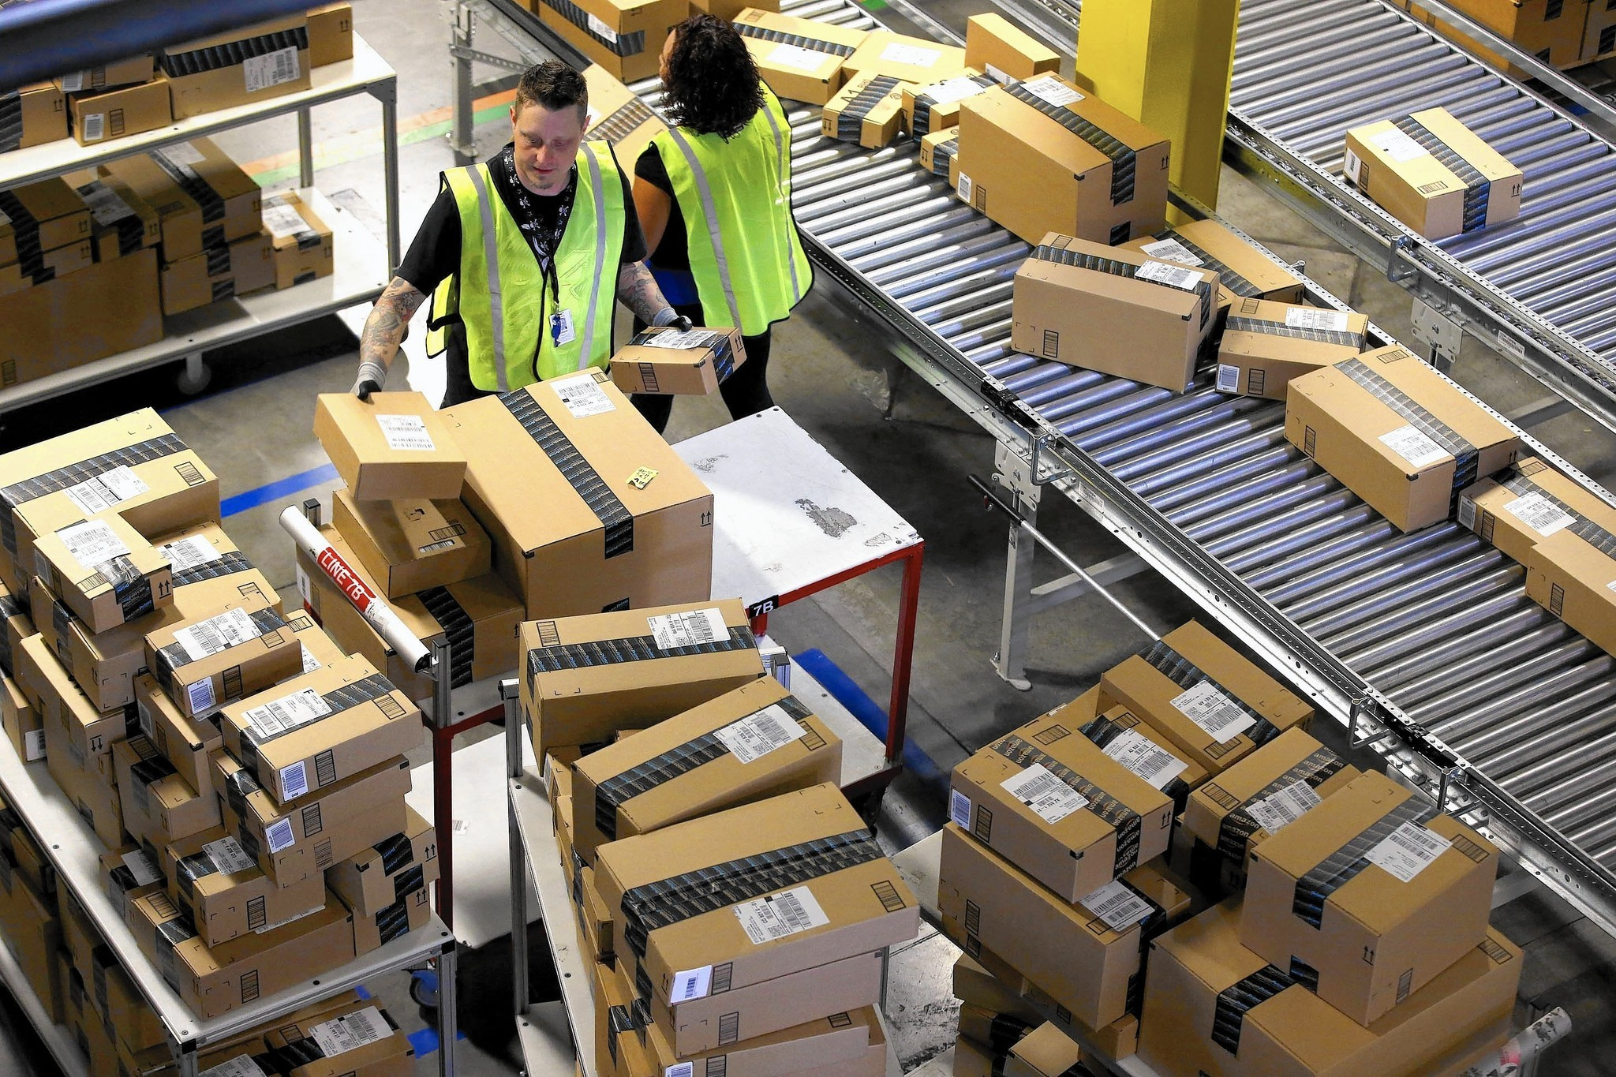
Meet the
Employer
Are you interested in working for Amazon?
Amazon’s mission is “to be Earth’s most customer-centric company” and our Operations and award-winning Customer Service teams are at the heart of that mission.
Join us to learn what warehouse positions (starting at $15.00hr) are available at Amazon available and how to apply on their website.
The Community Employment Center can help you prepare and apply! Ask us how!
Thursday, July 11^{h} | 10:00am – 12:00pm
Goodwill Princess Anne Retail Store
1949 Lynnhaven Parkway| Virginia Beach, VA 23453
(757) 951-4200
www.goodwillvirginia.org

